Slide 1



Pacific Europe NETWORK for Science and Technology
“Linking Science and Technology to Pacific development goals and needs”
SPC - Olivier Auguin
Seventh framework programme
CAPACITIES specific programme Activities of international cooperation
Grant Agreement for: Coordination Support Action
Grant Agreement no.: 244514
1

Slide 2
“Identify existing linkages between S&T and development goals of the Pacific”
Purpose: identify existing linkages between development goals and scientific research in the Pacific region
Methodology: 136 development documents from different S&T stakeholders were studied for mention of S&T themes and cross-cutting issues.
Outcome: 15 S&T themes emerged as priorities
More details on www.pacenet.eu
4

Slide 3
“Identify existing linkages between S&T and development goals of the Pacific”
- Priorities for the Pacific islands : themes more frequently-mentioned
5

Slide 4
“Identify existing linkages between S&T and development goals of the Pacific”
Analysis “15 Priority themes and EU’s 8 R&D sector”
5 R&D sectors have emerged as science focal areas for the Pacific islands
EU defined R&D sectors 15 pacific themes | Agriculture and food supply | Biology and medicine | Energy | Environment and climate | Industry and industrial technology | ICT | Social and economic concerns | Transport and construction
Environment | x | x | x | x |  |  | x | x
health | x | x |  |  |  |  | x
Biodiversity | x |  |  | x |  |  | x
Climate change | x | x | x | x |  |  | x
Fisheries and aquaculture | x | x |  | x |  |  | x
Agriculture and forestry | x | x |  | x |  |  | x
Culture, social and human sciences | x | x | x | x | x | x | x
Disaster management |  | x |  | x
Energy |  |  | x | x | x |  | x | x
Food security | x | x |  |  |  |  | x
waste and pollution |  | x | x | x | x |  | x | x
Water and sanitation | x | x |  | x |  |  | x
ICT |  |  |  |  |  | x | x
Mineral resources |  |  |  | x | x |  | x

Slide 5
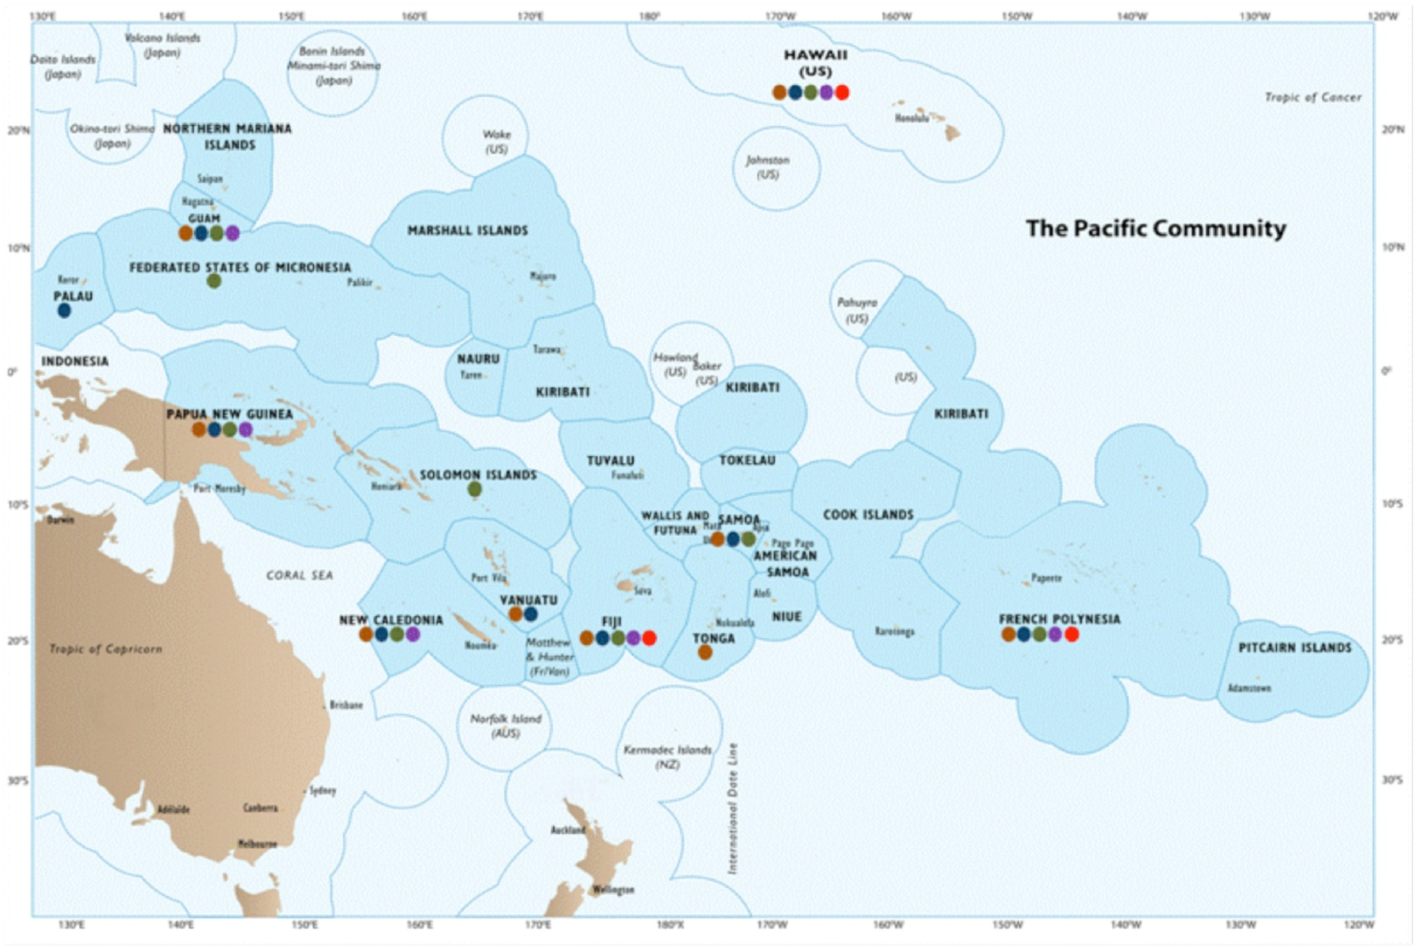
“Identify existing linkages between S&T and development goals of the Pacific”
R&D sectors of Pacific research institutions in the Pacific Islands countries and Territories
Social and economic concerns Environment and climate
Agriculture, forestry and food security Biology and medicine (Health) Energy

Slide 6
“Identify existing linkages between S&T and development goals of the Pacific”
In brief :
  First time in the Pacific we link research with development goals and with European R&D priorities
  5 themes have emerged : Agriculture&Food supply, Biology&Medecine, Environment&Climate, Energy, Social concerns
  Only few countries mention the importance of research in their national plans
  Research concentrated in few countries
  Role of Pace-Net to improve the situation :
  - to identify the gaps we have to fill in in the Pacific
  - to develop the networking and partnerships

